Slide 1
Lecture 10: Introduction to Hypothesis Testing
Jibo He, Ph.D.
Associate Professor
Wichita State University
jibo.he@Wichita.edu

Slide 2
Review of key concepts and theorems
Sampling distribution
A distribution of a statistic
The sampling distribution could be obtained through sampling with replacement
Sampling distribution of mean—central limit theorem
Notes:
On the other hand, last time, we talked about CLT, which provides a sound statistical theory to show that certain sampling distribution, such as the sampling distribution of mean, could be well approximated by normal distribuiton.
t, F, chi-square….
Sampling distributions tell us what values we might or might not expect to obtain for a particular statistic under a set of predefined conditions (e.g., what the sample differences between our two samples might be expected to be if the true means of the populations from which those samples came are equal.)

Slide 3
HYPOTHESIS TESTING
Chapter 7 of the Book

Slide 4
Inferential statistics
Null Hypothesis Significance Testing (NHST)
“A formal statement of the relations among the independent and dependent variables in a given area of research” (Smith and Davis, p. 14)
Examples of research questions NHST targets at
Is the population parameter equal to (or different from) a particular value?
Do undergraduates attitudes toward drinking differ from graduate students?
Notes:
The reason we care about sampling distribution is because we want to test hypothesis.
Let us go back to the previous example

Slide 5
Logic of Hypothesis Testing
The idea of NHST
Set up a particular hypothesis based on population parameters (null hypothesis and alternative hypothesis)
Null hypothesis is typically opposite to our research question.
A null hypothesis is the hypothesis that is tested. It can be a statement of no difference, or a statement of no relationship.
Normally we assume the Null hypothesis is true, and check the data to see if this conclusion is appropriate.
Notes:
You might find the logic a little rough , you might have to go over it again and again. The logic of hypothesis testing is an essential element in the world of inferential statistics

Slide 6
Why we set up a null hypothesis that is directly counter to what we hope to show?
NHST is (sort of) based on Popperian philosophy (Karl Popper)
“Science can never prove a theory but can only disconfirm.”
we can never prove something to be true, but we can prove something to be false
Notes:
People are frequently puzzled by the fact that we
For example, if we hope to demonstrate the research hypothesis that college students do not come from a population with mean self-confidence score of 100, we immediately set up the null hypothesis that they do.
It is hard to prove that the hypothesis we are interested in is true, but it is easy to show the opposite is false.

Slide 7
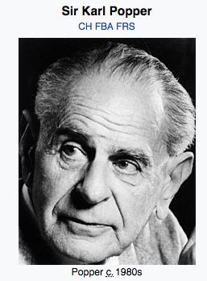
Popperian philosophy (Karl Popper)
“Science can never prove a theory but can only disconfirm.”

Slide 8
Characteristics of the Null and Alternative Hypothesis
H₀ and H_{A} denote the null and alternative hypothesis, respectively;
Remember, hypothesis always refers to population parameters
For every alternative hypothesis, there is always a corresponding null hypothesis
Example
If H_{A}: μ₁ ≠ μ₂ then H₀: μ₁ = μ₂
If H_{A}: μ ≠ 29 then H₀: μ = 29

Slide 9
Characteristics of the Null and Alternative Hypothesis
Pairs of statistical hypotheses (the null and the corresponding alternative) always involve the same parameters and contain relations that are mutually exclusive and exhaustive
When H₀: = then H_{A}: ≠
When H₀: ≤ then H_{A}: >
When H₀: ≥ then H_{A}: <
H_{A} is consistent with the research hypothesis; H₀ is the logical opposite of H_{A}
H₀ is actually tested and is either rejected or retained

Slide 10
Directional or Non-directional hypothesis
If the alternative hypothesis contains “≠”, it is a non-directional hypothesis. The hypothesis test is called a two-tailed test
If the alternative hypothesis contains “>” or “<”, it is a directional hypothesis. The hypothesis test is called a one-tailed test

Slide 11
Example
Research question:
I believe that the average GPA of American college students is more than 2.7
Statistical hypothesis:
H₀: μ ≤ 2.7 and H_{A}: μ > 2.7

Slide 12
Practice example: 1
A teacher is interested in seeing if using computers in his teaching will improve students’ understanding. He randomly chooses students for two groups and teaches the exact same things, under the exact same conditions for both groups. The only difference is that he uses computers in his teaching for the first group and not for the second. He then applies a test to assess their understanding. He believes that the first group will do better.

Slide 13
Practice example: 1
A teacher is interested in seeing if using computers in his teaching will improve students’ understanding. He randomly chooses students for two groups and teaches the exact same things, under the exact same conditions for both groups. The only difference is that he uses computers in his teaching for the first group and not for the second. He then applies a test to assess their understanding. He believes that the first group will do better.
H₀: μ₁ ≤ μ₂ and H_{A}: μ₁ > μ₂

Slide 14
Practice example: 2
In 1995, the “Times” reported that the mean travel time to work in 1980 for all Maryland residents was 13.00 minutes (with a standard deviation of 11.5). A transportation official obtained this year’s travel times, in minutes, for a random sample of 35 Maryland residents. He is interested in seeing if the mean travel time has changed from that in 1980

Slide 15
Practice example: 2
In 1995, the “Times” reported that the mean travel time to work in 1980 for all Maryland residents was 13.00 minutes (with a standard deviation of 11.5). A transportation official obtained this year’s travel times, in minutes, for a random sample of 35 Maryland residents. He is interested in seeing if the mean travel time has changed from that in 1980
H₀: μ = 13 and H_{A}: μ ≠ 13

Slide 16
Reasoning behind Hypothesis Testing
In statistical testing, we want to know something about a population parameter (research question).
We then produce statistical hypotheses for those parameters of interest and see which one is true.
Since we can never assess the whole population, sample data are collected and a test statistic that is directly related to the parameter we are interested in is computed.

Slide 17
Reasoning behind Hypothesis Testing
If the sample statistic is close to the hypothesized parameter, then we fail to reject (retain) the H₀. If it is very different, then we will reject H₀. But how do we decide if it is close enough or not??

Slide 18
Reasoning behind Hypothesis Testing
The sampling distribution when Null hypothesis is true (the Null Sampling Distribution) tells us what we should expect about the sample statistic.
We then compute a sample statistic from an observed sample
Then, we can compare our sample statistic to that distribution and decide either to reject or retain the null hypothesis.
Remember the concept of “probability”—what is the probability of observing a particular sample statistic if our sample is actually drawn from a certain population assumed by Null hypothesis.

Slide 19
Extreme score and probability
A normal curve is, after all, a probabilistic distribution. It gives you a statement of probabilities associated with various portions of the curve.
For instance, there is a 99% chance, or probability, that a score in a normal distribution will fall somewhere between 2.58 standard deviations above and below the mean.
What is an extreme score? It is a score or value that has a low probability of occurrence.
For instance, Z value of -2.01 is extreme.

Slide 20
Single sample test with σ known
A team of industrial psychologists is interested in the productivity of assembly line workers. Historical data, based on the performance of all workers over the past three years, indicate that workers will (on average) produce 193.8 units per day (σ=31.55). The psychologists, however, believe that the level of productivity may be different for workers who have been given the option of a flexible time schedule. Taking a sample of productivity records for those working on a flexible time schedule, the psychologists can compare the sample mean with the historical population mean.
Write out the Null and alternative hypothesis.

Slide 21
Steps in Testing Hypotheses
Step 1. Based on the research question, specify the appropriate null & alternative hypotheses (H_{A} and H₀)
Strategy: Model the researcher’s belief in H_{A}, set up H₀ as its logical opposite
Step 2. Specify the test to perform(e.g., one-sample z-test, t-test, independent t-test, dependent t-test, chi-square), the level of significance (usually 0.05), and the directionality of the test

Slide 22
Step 3. Sketch the sampling distribution of the test statistic with the region of rejection shaded and the critical value(s) (found from a proper table) clearly indicated
Step 4. Compute the test statistic using the sample data

Slide 23
Step 5. Locate the observed test statistic on the sampling distribution and state the decision regarding H₀ – reject H₀ or retain H₀
If the sample outcome is unlikely (given the null hypothesis is true), reject the null. hypothesis in favor of the alternative hypothesis.
If the sample outcome is likely (given the null hypothesis is true), fail to reject the null hypothesis.

Slide 24
Step 6. Interpret the results (draw an inference) to answer the researcher’s question (very important – do not forget this step!)

Slide 25
Criterion for Rejecting H₀
We would like to reject H₀ when it is false, and we don’t want to incorrectly reject H₀ when it is true. The framework we use for testing H₀ is the following:
If the actual result that we observe is unlikely to occur if H₀ is true, then we reject H₀. If the actual result is a “typical” outcome when H₀ is true, then we do not reject H₀. How unlikely? How typical? That is up to the researcher.

Slide 26
Criterion for Rejecting H₀
As a first step, we need to decide on the Level of Significance of the test. This value is denoted by the Greek letter α (alpha).
α =.05 means we are looking for a Z value that is so extreme it would occur by chance only 5% of the time, or less.
α is a conditional probability, that is it is the probability of incorrectly rejecting a true H₀. The level of significance must be set in advance by the researcher (typical values are 0.10, 0.05, and 0.01).

Slide 27
Critical Value & Critical Region
Value like +/- 1.96, +/-2.58 are called critical values---if our calculated test statistic meets or exceeds the critical value, then we can legitimately think of our observed difference (between sample mean and population mean) as being extreme. Critical value is determined by the level of significance.
Critical region (a.k.a. region of rejection) is the area or portion in a sampling distribution that contains all the values that allow you to reject the null hypothesis.

Slide 28
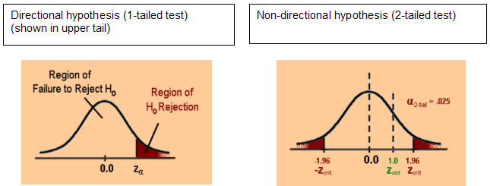
Graphic representation of the region of rejection and region of non-rejection
Notes:
The critical value is the beginning of the critical region. If our calculated test statistic meets or exceeds the critical value, thereby falling into the critical region, we are in a position to reject the null hypothesis.

Slide 29
One-tailed Test
When the alternative hypothesis is directional (H_{A} contains “>” or “<”), we are interested in looking at just one tail of the sampling distribution.
We need only one critical value
If the alternative hypothesis has a “>”, we will look for a critical value at the upper tail of the null distribution;
If the alternative hypothesis has a “<”, we will look for a critical value at the lower tail of the null distribution
The area corresponding to the region of rejection is equal to α.

Slide 30
Two-tailed Test
When the alternative hypothesis is non-directional (H_{A} contains “≠”),
We are interested in looking at both tails of the sampling distribution
We need two critical values
The area that each critical value corresponds to will be half of the value of α.

Slide 31
Criterion for Rejecting H₀
Then we need to compute the probability, assuming H₀ is true, of obtaining a result more extreme than the observed test statistics. This probability value is called the p-value.
After computing the p-value, we then compare it to the significance level that we have chosen. If the p-value is lower than the significance level α, then we reject H₀. Otherwise, we do not reject H₀.

Slide 32
Criterion for Rejecting H₀
For common tests that we will learn in this class, we need not directly compute the p-values.
Instead, we compute a test statistic that we can compare to one or more Critical Values that are determined by: α and the type of test.
Comparing observed test statistics to critical values is the same thing comparing p-values to α, but is often easier mathematically.

Slide 33
Summary of NHST
Set up the null hypothesis, H0
The samples were in fact drawn from populations with the same means
Calculate sample statistics, and figure out sampling distributions
Normal distribution
t-distribution
Chi-square distribution
F-distribution
Make decisions: we must decide whether an event with a probability of, say, 0.006, is sufficiently unlikely to reject null hypothesis.
Notes:
The cut-off probability is the “rejection level”, or the significance level. Whenever the probability obtained under H_0 is less than or equal to our predetermined significance level, we will reject null hypothesis
Using the sampling distribution under the null:
We determine the distribution of a statistic and find the
likelihood of observing the statistic we did given the null being
true.

Slide 34
Type I and II errors
A type I error occurs when the null hypothesis (H0) is true, but is rejected. It is asserting something that is absent, a false hit. A type I error may be likened to a so-called false positive (a result that indicates that a given condition is present when it actually is not present).
A type II error occurs when the null hypothesis is false, but erroneously fails to be rejected. It is failing to assert what is present, a miss. A type II error may be compared with a so-called false negative (where an actual 'hit' was disregarded by the test and seen as a 'miss') in a test checking for a single condition with a definitive result of true or false. A Type II error is committed when we fail to believe a true alternative hypothesis.
The type I error rate or significance level is the probability of rejecting the null hypothesis given that it is true. It is denoted by the Greek letter α (alpha) and is also called the alpha level. Often, the significance level is set to 0.05 (5%), implying that it is acceptable to have a 5% probability of incorrectly rejecting the null hypothesis.
The rate of the type II error is denoted by the Greek letter β (beta) and related to the power of a test (which equals 1−β).

Slide 35
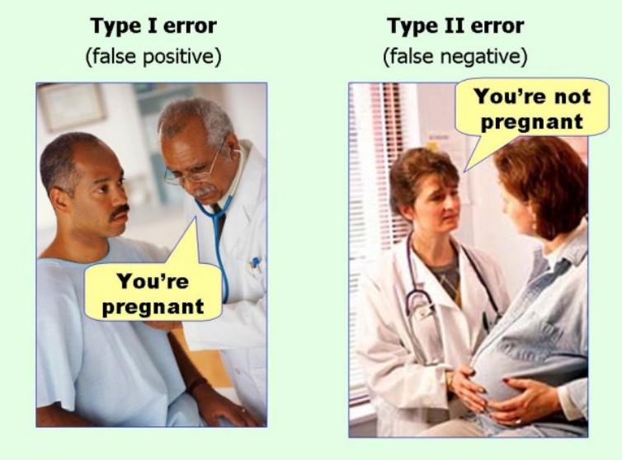
Type I and II errors

Slide 36
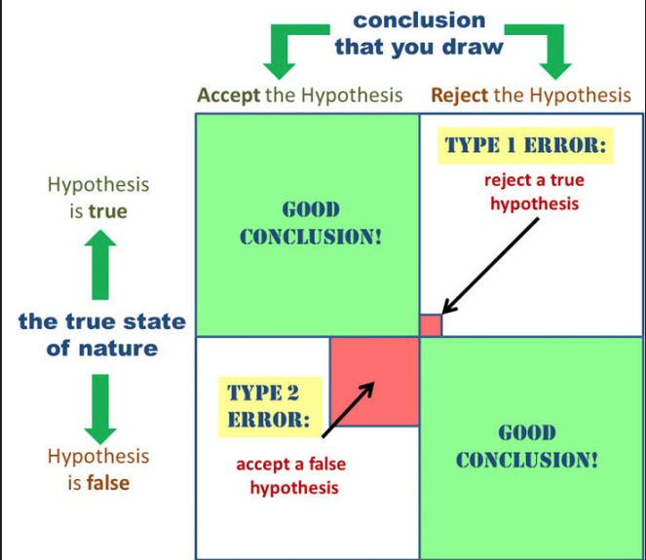
Type I and II errors

Slide 37
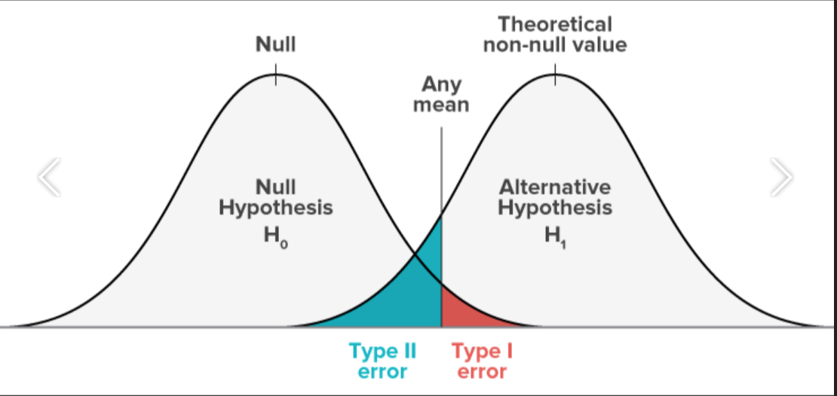
Type I and II errors

